Slide 1
Software Quality Assurance
/
Software Quality Engineering
Lecture 14
Naseer Ahmed

Slide 2
Standards, Certification And Assessment
The Benefits Of Use Of Standards
■ The ability to apply software development and maintenance
methodologies and procedures of the highest professional level
■ Better mutual understanding and coordination among development teams but especially between development and maintenance teams
■ Greater cooperation between the software developer and external participants in the project
■ Better understanding and cooperation between suppliers and customers, based on the adoption of known development and maintenance standards as part of the contract

Slide 3
Standards, Certification And Assessment
The Organizations Involved In Standards Development
Development of SQA standards has been undertaken by several national and international standards institutes, professional and industry-oriented organizations that invest remarkable amounts of resources in these projects.
The following institutes and organizations, among the most prominent developers of SQA and software engineering standards, have gained international reputation and standing in this area:
■ IEEE (Institute of Electrical and Electronics Engineers) Computer Society
■ ISO (International Organization for Standardization)
■ DOD (US Department of Defense)
■ ANSI (American National Standards Institute)
■ IEC (International Electrotechnical Commission)
■ EIA (Electronic Industries Association).

Slide 4
Standards, Certification And Assessment
Classification Of SQA Standards
Software quality assurance standards can be classified into two main classes:
■ Software quality assurance management standards, including certification and assessment methodologies (quality management standards)
■ Software project development process standards (project process standards)

Slide 5
Standards, Certification And Assessment
Classification Of SQA Standards
Quality Management Standards
These focus on the organization’s SQA system, infrastructure and requirements, while leaving the choice of methods and tools to the organization. By complying with quality management standards, organizations can steadily assure that their software products achieve an acceptable level of quality.
ISO 9000-3 and the Capability Maturity Model (CMM) are, respectively, examples of a standard and a methodology belonging to this class. Some current software development tenders require participants to be certified according to one of the quality management standards.

Slide 6
Standards, Certification And Assessment
Classification Of SQA Standards
Project Process Standards
These focus on the methodologies for carrying out software development and maintenance projects, that is, on “how” a software project is to be implemented. These standards define the steps to be taken, design documentation requirements, the contents of design documents, design reviews and review issues, software testing to be performed and testing topics, and so forth.
Naturally, due to their characteristics, many SQA standards in

Slide 7
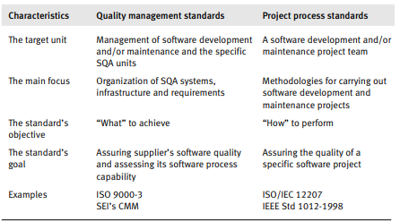
Standards, Certification And Assessment
Classification Of SQA Standards

Slide 8
Quality Management Standards
Classification Of SQA Standards
Project Process Standards
These focus on the methodologies for carrying out software development and maintenance projects, that is, on “how” a software project is to be implemented. These standards define the steps to be taken, design documentation requirements, the contents of design documents, design reviews and review issues, software testing to be performed and testing topics, and so forth.
Naturally, due to their characteristics, many SQA standards in

Slide 9
Quality Management Standards
Certification standards vary from assessment standards by content as well as by emphasis.
The scope of certification standards is determined by the aims of certification, which are to:
■ Enable a software development organization to demonstrate consistent ability to assure that its software products or maintenance services comply with acceptable quality requirements. This is achieved by certification granted by an external body
■ Serve as an agreed basis for customer and supplier evaluation of the supplier's quality management system. This may be accomplished by customer performance of a quality audit of the supplier’s quality management system. The audit will be based on the certification standard’s requirements.

Slide 10
Quality Management Standards
■ Support the software development organization’s efforts to improve quality management system performance and enhance customer satisfaction through compliance with the standard’s requirements.
The scope of assessment standards is also determined by the aims of assessment, which are to:
■ Serve software development and maintenance organizations as a tool for self-assessment of their ability to carry out software development projects.
■ Serve as a tool for improvement of development and maintenance processes. The standard indicates directions for process improvements.

Slide 11
Quality Management Standards
■ Help purchasing organizations determine the capabilities of potential suppliers.
■ Guide training of assessors by delineating qualifications and training program curricula.
To sum up, while the certification standards emphasis is external – to support the supplier–customer relationships – the emphasis of the assessment standards is internal because it focuses on software process improvement.

Slide 12
Quality Management Standards
■ Help purchasing organizations determine the capabilities of potential suppliers.
■ Guide training of assessors by delineating qualifications and training program curricula.
To sum up, while the certification standards emphasis is external – to support the supplier–customer relationships – the emphasis of the assessment standards is internal because it focuses on software process improvement.

Slide 13
Quality Management Standards
ISO 9001 and ISO 9000-3
Eight principles guide the new ISO 9000-3 standard; these were originally set down in the ISO 9000:2000 standard (ISO, 2000b), as follows:
(1) Customer focus. Organizations depend on their customers and therefore should understand current and future customer needs.
(2) Leadership. Leaders establish the organization’s vision. They should create and maintain an internal environment in which people can become fully involved in achieving the organization’s objectives via the designated route.
(3) Involvement of people. People are the essence of an organization; their full involvement, at all levels of the organization, enables their abilities to be applied for the organization’s benefit.
(4) Process approach. A desired result is achieved more efficiently when activities and resources are managed as a process.

Slide 14
Quality Management Standards
ISO 9001 and ISO 9000-3
(5) System approach to management. Identifying, understanding and managing processes, if viewed as a system, contributes to the organization’s effectiveness and efficiency.
(6) Continual improvement. Ongoing improvement of overall performance should be high on the organization’s agenda.
(7) Factual approach to decision making. Effective decisions are based on the analysis of information.
(8) Mutually supportive supplier relationships. An organization and its suppliers are interdependent; a mutually supportive relationship enhances the ability of both to create added value

Slide 15
Quality Management Standards
ISO 9001 and ISO 9000-3
ISO 9000-3: Requirements
The current standard edition of ISO, 9000-3 (ISO 1997) includes 20 requirements that relate to the various aspects of software quality management systems. The new ISO 9000-3 (ISO/IEC, 2001) offers a new structure, with its 22 requirements classified into the following five groups:
■ Quality management system
■ Management responsibilities
■ Resource management
■ Product realization
■ Management, analysis and improvement.

Slide 16
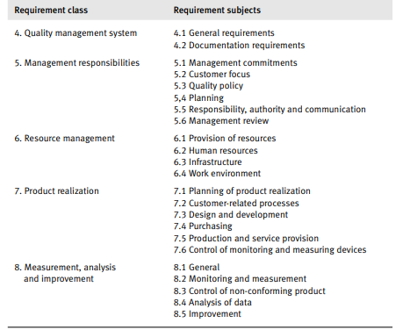
Quality Management Standards
ISO 9001 and ISO 9000-3
ISO 9000-3: Requirements

Slide 17
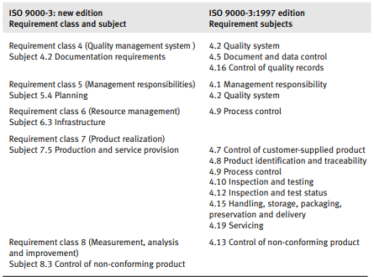
Quality Management Standards
ISO 9001 and ISO 9000-3
ISO 9000-3: Requirements

Slide 18
Quality Management Standards
Capability Maturity Models – CMM And CMMI
Assessment Methodology
CMM assessment is based on the following concepts and principles:
■ Application of more elaborate management methods based on quantitative approaches increases the organization’s capability to control the quality
and improve the productivity of the software development process.
■ The vehicle for enhancement of software development is composed of the five-level capability maturity model. The model enables an organization to evaluate its achievements and determine the efforts needed to reach the next capability level by locating the process areas requiring improvement.

Slide 19
Quality Management Standards
Capability Maturity Models – CMM And CMMI
Assessment Methodology
■ Process areas are generic; they define the “what”, not the “how”. This approach enables the model to be applied to a wide range of implementation organizations because:
– It allows use of any life cycle model
– It allows use of any design methodology, software development tool and programming language
– It does not specify any particular documentation standard.

Slide 20
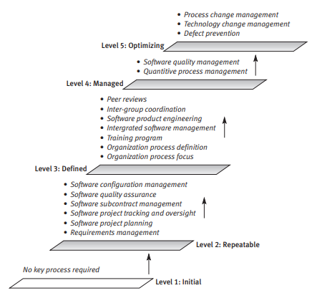
Quality Management Standards
Capability Maturity Models – CMM And CMMI
Assessment Methodology
The CMM and its key process areas (KPAs) are presented

Slide 21
Quality Management Standards
Capability Maturity Models – CMM And CMMI
Assessment Methodology
In the late 1990s a new developmental direction was taken – development of integrated CMM models. Development of specialized CMM models involved development of different sets of key processes for model variants for different departments that exhibited joint processes
The CMMI model, like the original CMM models, is composed of five levels. The CMMI capability levels are the same as those of the original, apart from a minor change related to capability level 4, namely:
■ Capability maturity level 1: Initial
■ Capability maturity level 2: Managed
■ Capability maturity level 3: Defined
■ Capability maturity level 4: Quantitatively managed
■ Capability maturity level 5: Optimizing

Slide 22
Quality Management Standards
ISO/IEC 15504 software process assessment standard
The parallel development of several software process assessment methodologies raised difficulties of non-standardization. A joint initiative by ISO and IEC, the SPICE (Software Process Improvement for Capability Determination) Project was established in 1993 to overcome this problem by developing a standard software process assessment methodology.
The assessment model is composed of six levels of capability, where level 0 is the lowest and level 5 the highest. The model defines which process attributes have to be attained to achieve each capability level. Process attributes are generic, defining “what”, not “how”, in order to allow conformity of existing assessment models to the ISO/IEC standard

Slide 23
Quality Management Standards
ISO/IEC 15504 software process assessment standard
Capability levels and process attribute requirements
Level 0: Incomplete. No process attributes are expected. There is no (or only little) implementation of any planned or identified process.
Level 1: Performed process. Process attribute: Process performance includes identifying processes and their inputs and outputs.
Level 2: Managed process. Process attributes:
(a) Performance management – processes performed according to procedures; their progress is controlled.
(b) Work products management – work products are controlled and documented; their compliance is verified.

Slide 24
Quality Management Standards
ISO/IEC 15504 software process assessment standard
Level 3: Established process. Process attributes:
(a) Process definition – the organization applies well-defined processes throughout. Processes tailored to any specific project originate in standard processes.
(b) Process resources – the organization controls use of project resources: human resources, infrastructure resources, etc.
Level 4: Predictable process. Process attributes:
(a) Measurement – performance measurement supports achievement of project goals.
(b) Process control – the organization controls processes by collection of data on performance and product measures, analysis and implementation of needed corrections of process performance to achieve process goals.

Slide 25
Quality Management Standards
ISO/IEC 15504 software process assessment standard
Level 5: Optimizing process. Process attributes:
(a) Process change – the organization initiates and controls processes and managerial systems to improve its effectiveness and efficiency for achievement of its business goals.
(b) Continuous improvement – the organization persistently monitors the changes implemented through quantitative measurement to assure continuous improvement of processes and management.

Slide 26
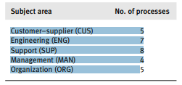
Quality Management Standards
ISO/IEC 15504 software process assessment standard
The ISO/IEC 15504 includes 29 processes that the organization has to perform successfully to reach capability level 5. The processes are grouped into
the following five subject areas:

Slide 27
Interview Questions
What is the difference between Quality Assurance, Quality Control, and Testing?
When do you think QA activities should start?
What is the difference between the Test Plan and Test Strategy?
Can you explain the Software Testing Life Cycle?
How do you define a format of writing a good test case?
What would you do if you have a large suite to execute in very less time?
Do you think QA’s can also participate to resolve production issues?
Suppose you find a bug in production, how would you make sure that the same bug is not introduced again?
What is the difference between Functional and Non-functional testing?

